Slide 1






OUTLIER DETECTION:
IDENTIFYING UNUSUAL DATA POINTS
AZEEZ AREGBESOLA
BEYOND THE NUMBERS

Slide 2




OUTLIER DETECTION:
IDENTIFYING UNUSUAL DATA POINTS
OUTLIERS ARE EXTREME VALUES THAT DIFFER SIGNIFICANTLY FROM THE REST OF THE DATA.
THEY CAN REVEAL INSIGHTS OR DISTORT ANALYSIS IF NOT HANDLED PROPERLY.
THIS POST WILL COVER:
Concept Introduction – What are outliers, and why do they matter?
Real-World Example – A fresh dataset showing outliers in action.
Simplified R Code – Step-by-step implementation.
Visualization – Boxplot and scatterplot highlighting outliers.
Key Takeaways – Summary.
AZEEZ AREGBESOLA
BEYOND THE NUMBERS

Slide 3




CONCEPT INTRODUCTION
📊 OUTLIER DETECTION: SPOTTING UNUSUAL DATA POINTS!
🔍 Why is this important?
Finance: Detect fraudulent transactions 💳
Healthcare: Identify abnormal patient test results 🏥
Manufacturing: Find defective products in a production line ⚙️
AZEEZ AREGBESOLA
BEYOND THE NUMBERS

Slide 4




REAL-WORLD EXAMPLE
IMAGINE YOU'RE ANALYZING EMPLOYEE SALARIES AT A COMPANY.
GOAL
SOLUTION
CHALLENGE
✅ Goal: Identify unusually high or low salaries that could impact pay equity.
✅ Challenge: Outliers could be legitimate (CEOs, executives) or errors (data entry mistakes).
✅ Solution: Use statistical methods to detect outliers.
AZEEZ AREGBESOLA
BEYOND THE NUMBERS

Slide 5

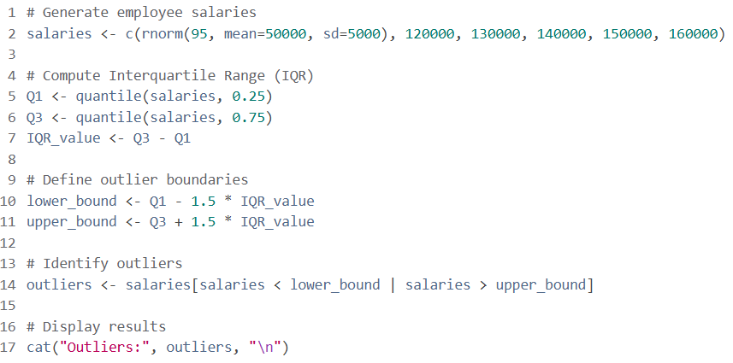
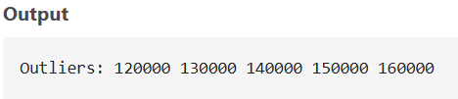
R IMPLEMENTATION
WE’LL GENERATE SYNTHETIC SALARY DATA AND DETECT OUTLIERS.
AZEEZ AREGBESOLA
BEYOND THE NUMBERS

Slide 6
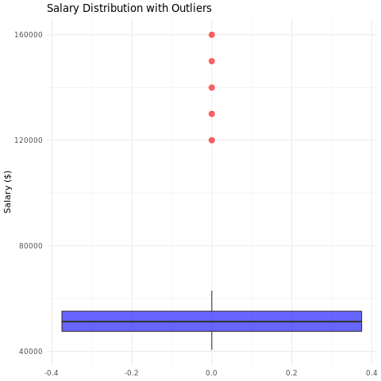
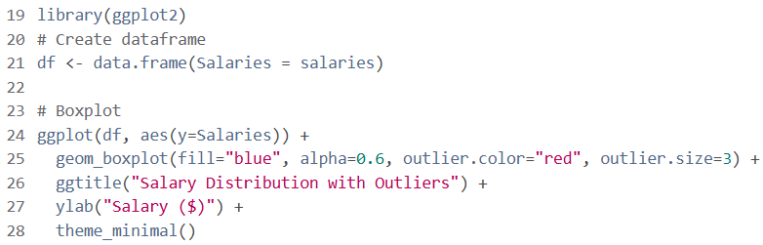
VISUALIZATION
LET’S VISUALIZE OUTLIERS WITH A BOXPLOT.
📌 THE RED POINTS REPRESENT OUTLIERS (EXTREMELY HIGH SALARIES IN THIS DATASET).
📌 BOXPLOTS MAKE IT EASY TO SPOT UNUSUAL DATA POINTS.
AZEEZ AREGBESOLA
BEYOND THE NUMBERS

Slide 7



KEY TAKEAWAYS
SUMMARY
✅ Outliers can indicate errors, fraud, or special cases.
✅ Use statistical methods like IQR, Z-score, and visualization for detection.
✅Handling outliers depends on the context, sometimes they should be removed, other times analyzed further.
AZEEZ AREGBESOLA
BEYOND THE NUMBERS

Slide 8


FROM DATA TO DECISIONS
AZEEZ AREGBESOLA
BEYOND THE NUMBERS

